Slide 1


ECHOES OF POPULARITY: AI-DRIVEN PREDICTION OF MUSIC STREAMING SUCCESS
DONE BY
VENKAT ROHAN SEETEPALLI

Slide 2
OVERVIEW
Introduction
Literature Review
Data Preprocessing
Exploratory Data Analysis
Methodology
Data Modelling and Evaluation
Real-time Prediction
Summary
Future Scope

Slide 3

INTRODUCTION
Music streaming has revolutionized how we access and enjoy music. Song popularity is driven by musical traits (tempo, energy) and external factors (artist reputation, social trends). Using Machine learning and Deep learning, we analyze these influences to predict streaming success. Our insights empower artists, producers, and platforms to optimize music reach.

Slide 4
LITERATURE REVIEW
1
In the 2021 paper "Catching the Earworm: Understanding Streaming Music Popularity Using Machine Learning Models," Andrea Gao examines how audio features and artist information can predict music popularity on streaming platforms. The study employs machine learning models to identify key factors influencing a song's success, offering valuable insights for the music industry.
2
"Predicting Song Popularity" by James Pham, Edric Kyauk, and Edwin Park (2012) explores the use of machine learning algorithms to forecast a song's success. Utilizing the Million Song Dataset, the study evaluates various classification and regression models to identify key features influencing song popularity.
3
"Hit Songs Prediction: A Review on Machine Learning Perspective" by Kah Yee Yap and Mafas Raheem (2024) examines the evolution of Hit Song Science, focusing on the application of machine learning techniques to predict music popularity. The paper highlights the integration of audio features, lyrics analysis, and social media data, suggesting that future research should combine these elements to enhance prediction accuracy.

Slide 5

DATA PREPROCESSING

Slide 6
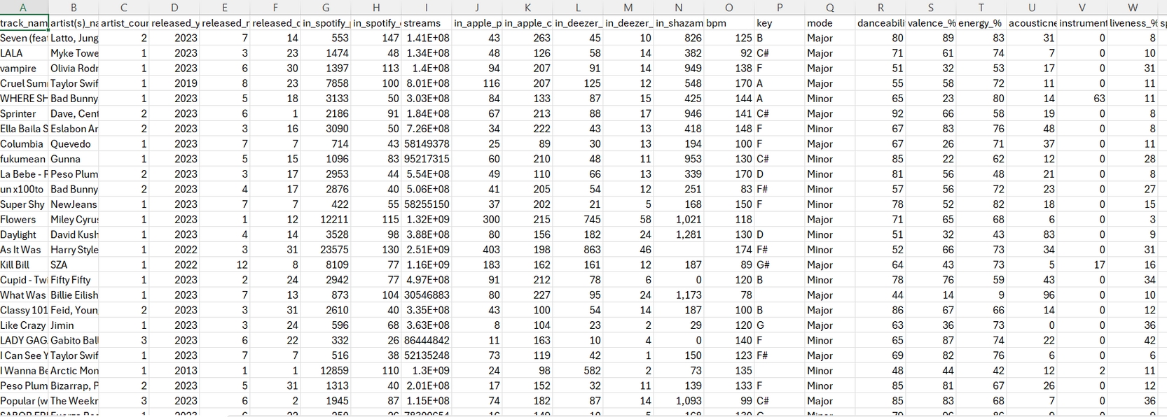
DATA
Dataset
My Dataset consists of 25 variables and 953 records
Source
https://www.kaggle.com/datasets/abdulszz/spotify-most-streamed-songs/datat
About the datset:
Our Kaggle dataset of 953 songs with 25 attributes captures both musical and market-driven factors behind streaming success. It includes audio features like energy, danceability, and valence, along with playlist presence and chart rankings. This unique blend of data provides a holistic view of what makes a song a hit. By analyzing these factors, we unlock patterns that drive music popularity

Slide 7
VarIables
CONTINUOUS
artist(s)_count
released_year
released_month
released_day
in_spotify_playlists
in_deezer_playlists
in_spotify_charts
in_apple_playlists
CONTINUOUS
in_deezer_charts
in_apple_charts
streams
bpm
danceability_%
valence_%
instrumentalness%
energy_%
CONTINUOUS
acousticness_%
liveness_%
speechiness_%
in_shazam_charts
CATEGORICAL
track_name
artist(s)_name
key
mode
cover_url

Slide 8
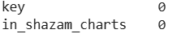
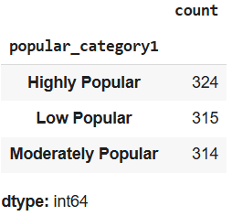
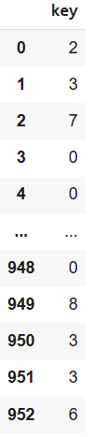
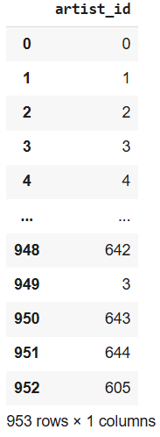
DATA CLEANING
Data Cleaning : Data cleaning is the process of identifying and correcting or removing inaccurate, incomplete, or irrelevant data from a dataset .The process performed for data cleaning are as follows:
Filled missing values in the “key” column with the mode and “in_shazam_charts” with mean.
Replaced “mode” column into 0's and 1's.
Converted “streams” column to numeric and created a new variable called “popular_category1” (target variable) and mapped into 0's, 1's and 2's.
Converted “in_deezer_playlists” and “in_shazam_charts” to numeric
Conducted Label Encoding for 2 columns- “artist_name” and “track_name”
Removed the column- “cover_url”

Slide 9
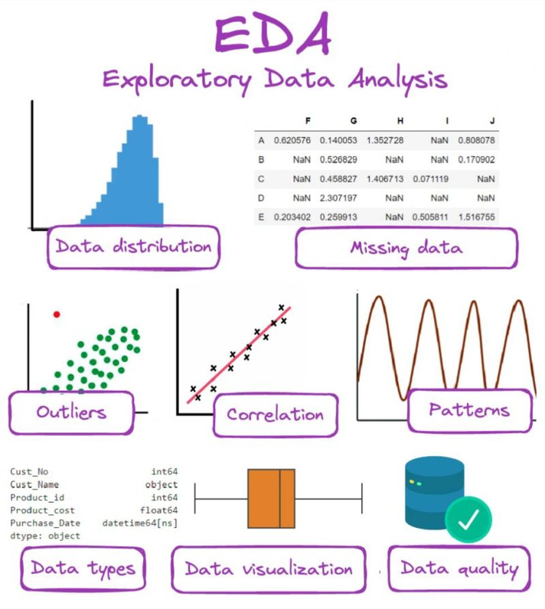
EXPLOARATORY DATA ANALYSIS

Slide 10
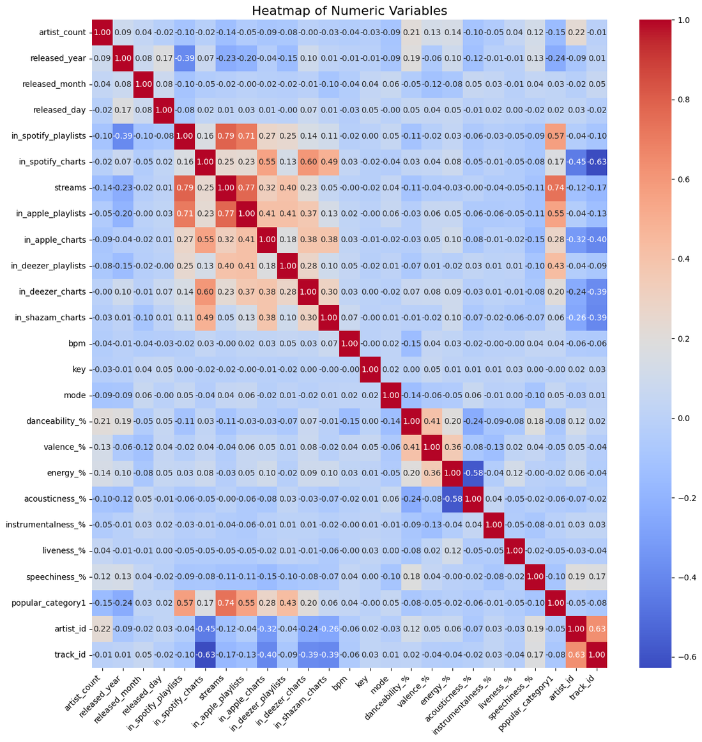
CORRELATION HEATMAP
This visualizes the relationships between numerical features. It highlights correlations, helping identify features that might be redundant or strongly associated.

Slide 11
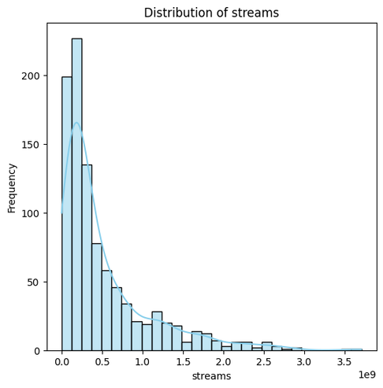
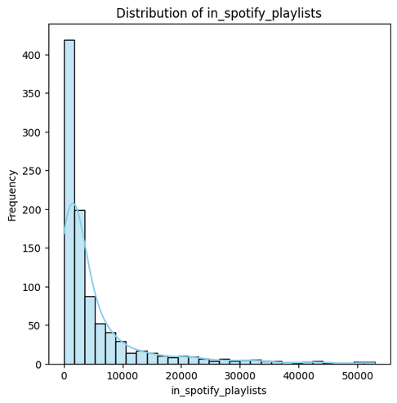
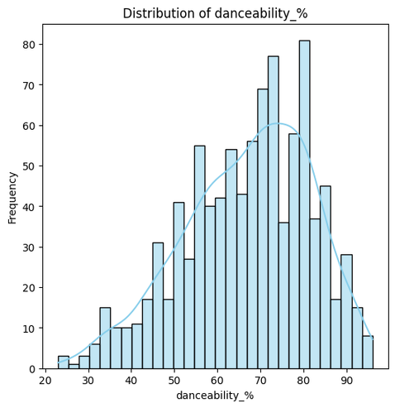
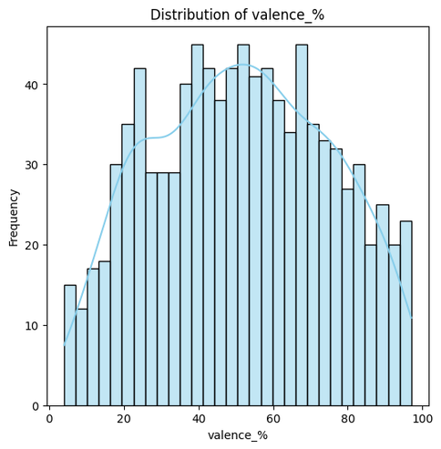
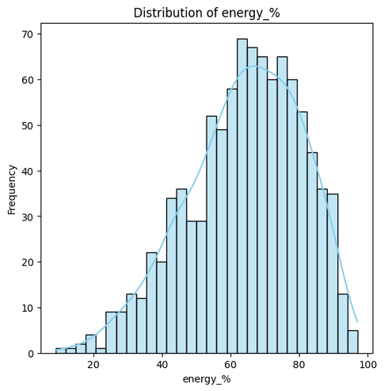
HISTOGRAM
Histograms show how the distribution of variables, helping us understand the frequency of different values for each feature.

Slide 12
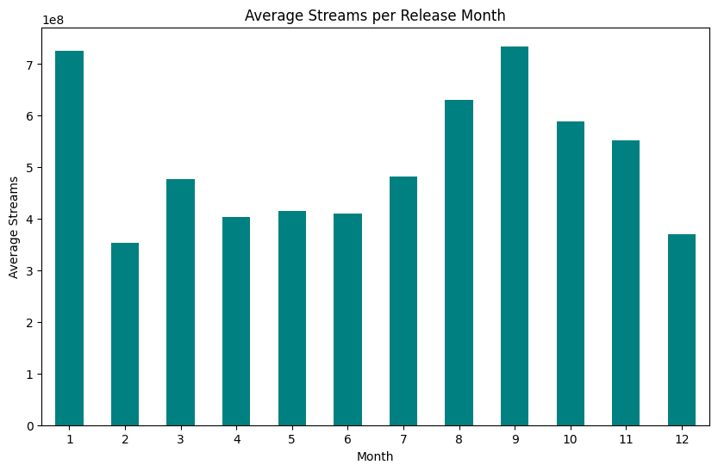
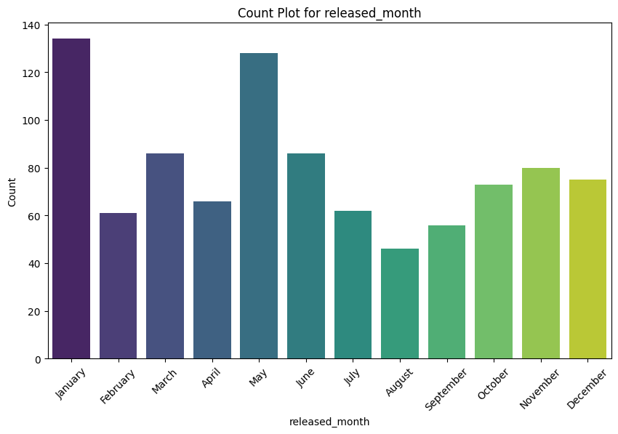
COUNT-PLOT
Count Plots give an idea of the categorical variables and their distributions. For example, for released_month.

Slide 13
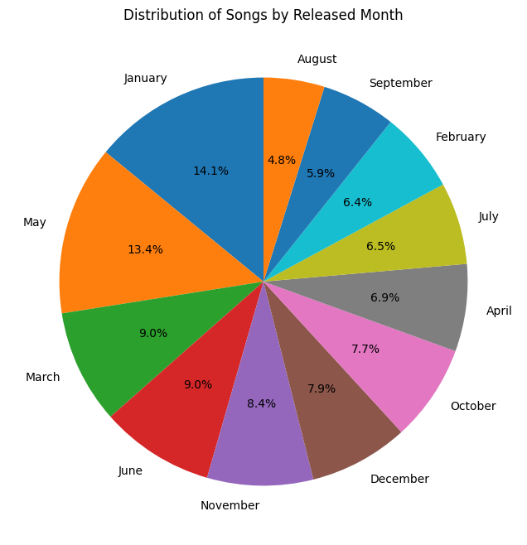
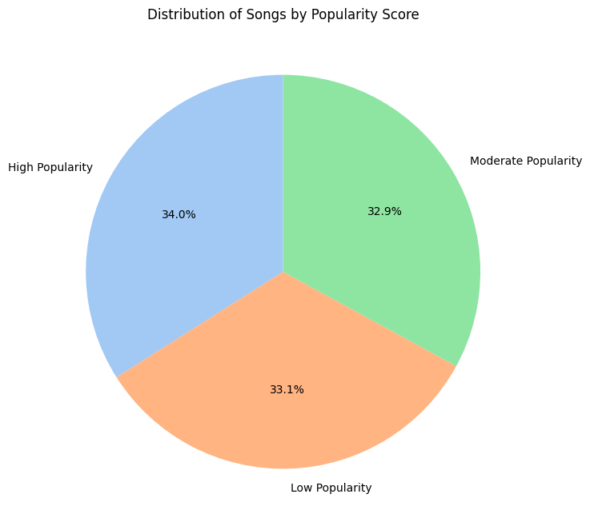
PIE-PLOT
Pie plots visually break down proportions of a variable.

Slide 14
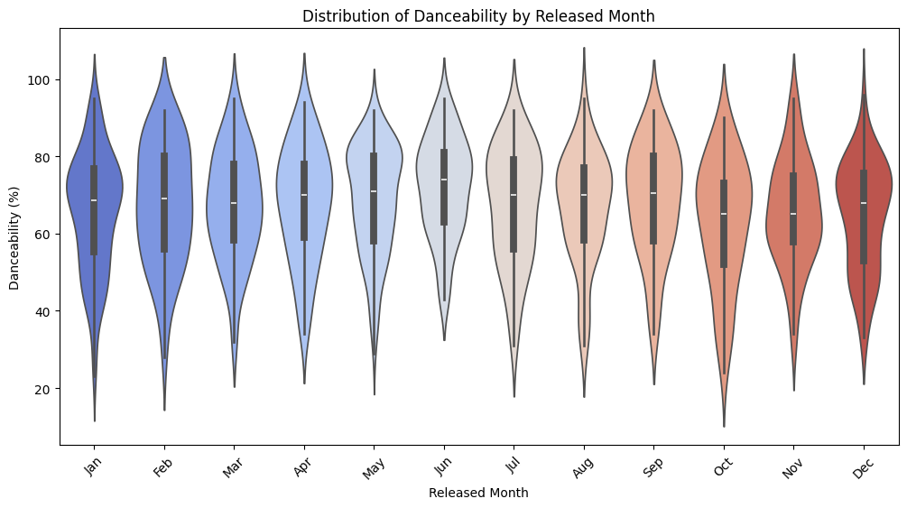
VIOLIN-PLOT
These plots show the spread and potential outliers for features. Violin plots combine box plot information with the distribution shape.

Slide 15
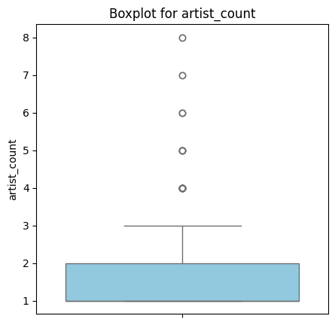
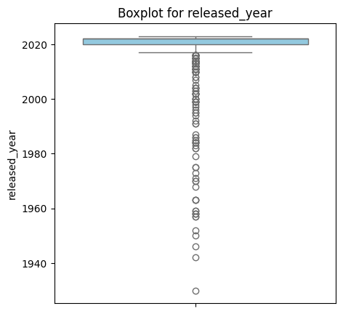
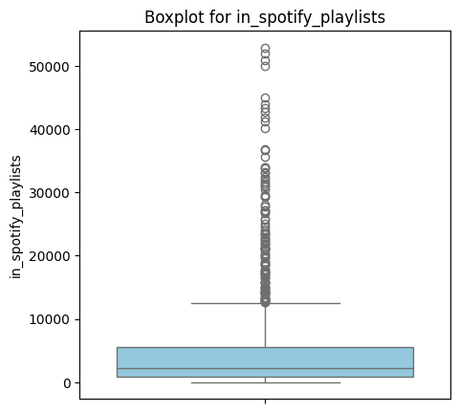
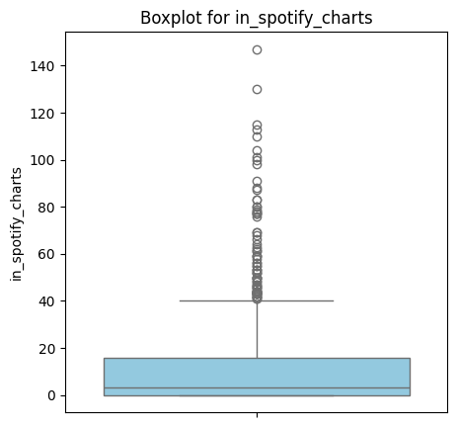
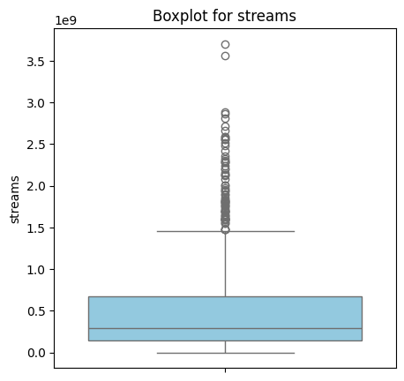
BOX-PLOT
Box plots summarize the distribution of data, highlighting the median, variability, and outliers for easy comparison.

Slide 16
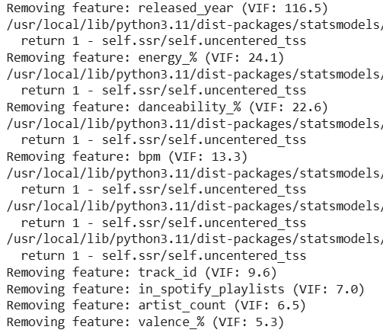
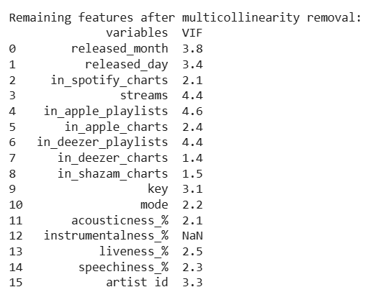
MULTI-COLLINEARITY CHECK
Multicollinearity occurs when independent variables in a model are too closely related or highly correlated , making it difficult to determine their individual effects on the dependent variable.

Slide 17

MACHINE LEARNING ALGORITHMS

Slide 18
MACHINE LEARNING ALGORITHMS
Logistic Regression: A classification algorithm that models the probability of a binary outcome using a logistic function. It predicts probabilities and applies a threshold to classify data points.
K-Nearest Neighbors (KNN): A non-parametric algorithm that classifies data based on the majority class of the nearest neighbors. It calculates the distance between data points to make predictions.
Support Vector Machine (SVM): A classification algorithm that finds the optimal hyperplane to separate classes in a highdimensional space. It uses support vectors to maximize the margin between classes.
Decision Tree: A tree-like model that splits the data into branches based on feature values to predict outcomes. Each internal node represents a decision, and each leaf node represents a final class or value.

Slide 19
MACHINE LEARNING ALGORITHMS
Random Forest: An ensemble learning method that creates multiple decision trees and aggregates their results to improve accuracy. It reduces overfitting by averaging the predictions of individual trees.
AdaBoost: An ensemble technique that combines weak classifiers to form a strong classifier by assigning higher weights to misclassified instances. It iteratively adjusts the weights to improve prediction accuracy.
XGBoost: A gradient boosting algorithm that improves model performance by combining multiple weak learners. It is optimized for speed and efficiency, often used for structured/tabular data.
CatBoost : A high-performance gradient boosting algorithm developed by Yandex, optimized for categorical data and known for handling missing values efficiently.

Slide 20
MACHINE LEARNING ALGORITHMS
Ridge Regression : A linear regression technique that applies L2 regularization to reduce overfitting by penalizing large coefficients and improving model generalization
Bagging : A machine learning ensemble method that improves accuracy by training multiple models on bootstrapped subsets of data and averaging their predictions.
Artificial Neural Networks (ANNs) : Computational models inspired by the human brain, consisting of interconnected layers of neurons used for complex pattern recognition and deep learning tasks.

Slide 21
80-20 SPLIT
ALGORITHMS | MODEL-1 Accuracy | MODEL-2 Accuracy
LOGISTIC REGRESSION | 0.841 | 0.890
RIDGE REGRESSION | 0.902 | 0.940
KNN | 0.853 | 0.841
SVM | 0.829 | 0.853
DECISION TREE | 0.926 | 0.902
RANDOM FOREST | 0.902 | 0.940
ADABOOST | 0.902 | 0.902
GRADIENT BOOST | 0.902 | 0.902
XG BOOST | 0.902 | 0.902
ALGORITHMS | MODEL-1 Accuracy | MODEL-2 Accuracy
CAT BOOST | 0.902 | 0.878
BAGGING | 0.902 | 0.890
ARTIFICIAL NEURAL NETWORKS | 0.878 | 0.914
Model-1: Before VIF | Model-2: After VIF

Slide 22
75-25 SPLIT
ALGORITHMS | MODEL-1 Accuracy | MODEL-2 Accuracy
LOGISTIC REGRESSION | 0.854 | 0.912
RIDGE REGRESSION | 0.912 | 0.912
KNN | 0.805 | 0.854
SVM | 0.844 | 0.864
DECISION TREE | 0.941 | 0.893
RANDOM FOREST | 0.902 | 0.903
ADABOOST | 0.902 | 0.903
GRADIENT BOOST | 0.902 | 0.903
XG BOOST | 0.902 | 0.903
ALGORITHMS | MODEL-1 Accuracy | MODEL-2 Accuracy
CAT BOOST | 0.902 | 0.903
BAGGING | 0.902 | 0.912
ARTIFICIAL NEURAL NETWORKS | 0.893 | 0.883
Model-1: Before VIF | Model-2: After VIF

Slide 23
70-30 SPLIT
ALGORITHMS | MODEL-1 Accuracy | MODEL-2 Accuracy
LOGISTIC REGRESSION | 0.846 | 0.910
RIDGE REGRESSION | 0.886 | 0.902
KNN | 0.764 | 0.878
SVM | 0.861 | 0.861
DECISION TREE | 0.926 | 0.910
RANDOM FOREST | 0.911 | 0.934
ADABOOST | 0.911 | 0.910
GRADIENT BOOST | 0.911 | 0.910
XG BOOST | 0.911 | 0.910
ALGORITHMS | MODEL-1 Accuracy | MODEL-2 Accuracy
CAT BOOST | 0.911 | 0.910
BAGGING | 0.911 | 0.870
ARTIFICIAL NEURAL NETWORKS | 0.894 | 0.926
Model-1: Before VIF | Model-2: After VIF

Slide 24
60-40 SPLIT
ALGORITHMS | MODEL-1 Accuracy | MODEL-2 Accuracy
LOGISTIC REGRESSION | 0.830 | 0.902
RIDGE REGRESSION | 0.853 | 0.926
KNN | 0.774 | 0.817
SVM | 0.835 | 0.853
DECISION TREE | 0.945 | 0.902
RANDOM FOREST | 0.902 | 0.932
ADABOOST | 0.902 | 0.902
GRADIENT BOOST | 0.902 | 0.902
XG BOOST | 0.902 | 0.902
ALGORITHMS | MODEL-1 Accuracy | MODEL-2 Accuracy
CAT BOOST | 0.902 | 0.884
BAGGING | 0.860 | 0.872
ARTIFICIAL NEURAL NETWORKS | 0.945 | 0.940
Model-1: Before VIF | Model-2: After VIF

Slide 25
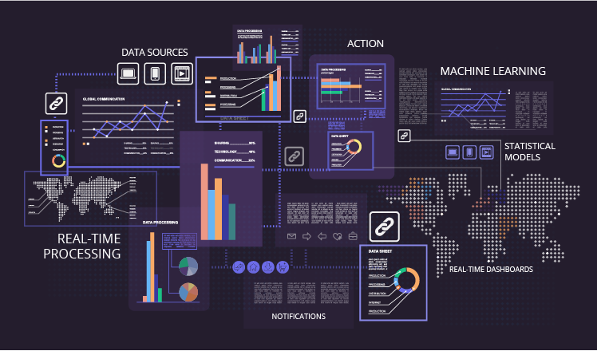
REAL-TIME PREDICTION

Slide 26
REAL-TIME PREDICTION
Our real-time song popularity prediction system analyzes an uploaded song file and predicts its potential success based on its unique audio characteristics.
When a user uploads an MP3 file, the system automatically extracts key features.
These extracted features are matched with patterns from our dataset, and a popularity score is calculated using our trained prediction model.
Based on the computed score, the song is categorized as:
Low Popular (Under 0.4)
Moderately Popular (Between 0.4 and 0.7)
Highly Popular (Above 0.7)
This AI-driven approach helps music producers, analysts, and streaming platforms understand a song’s potential impact, making data-driven decisions more effective.

Slide 27
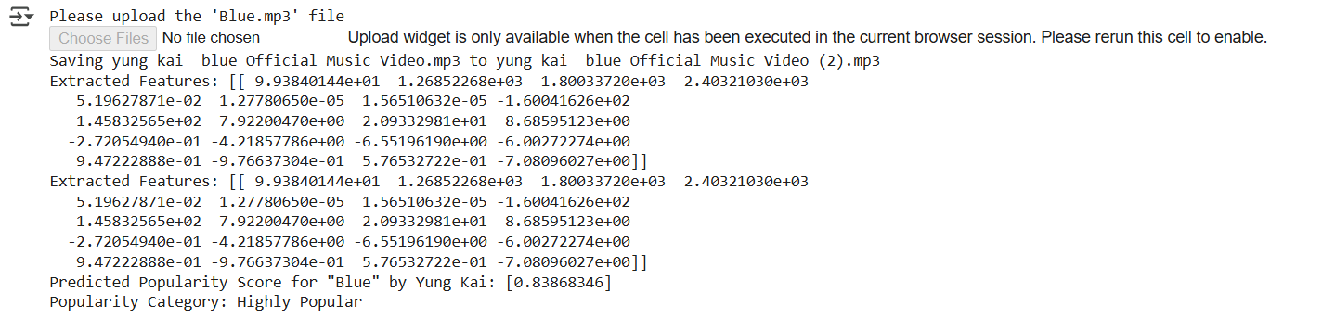
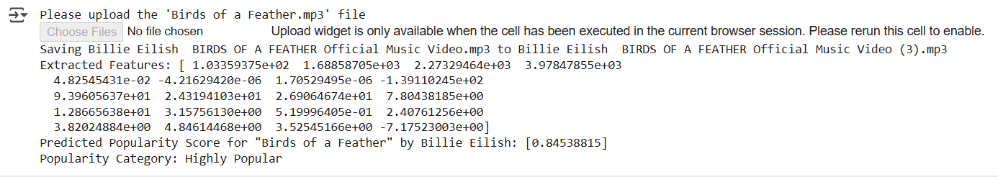
REAL-TIME PREDICTION

Slide 28
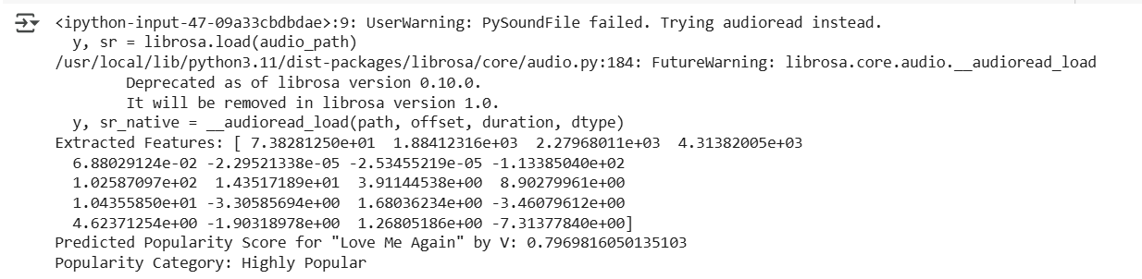
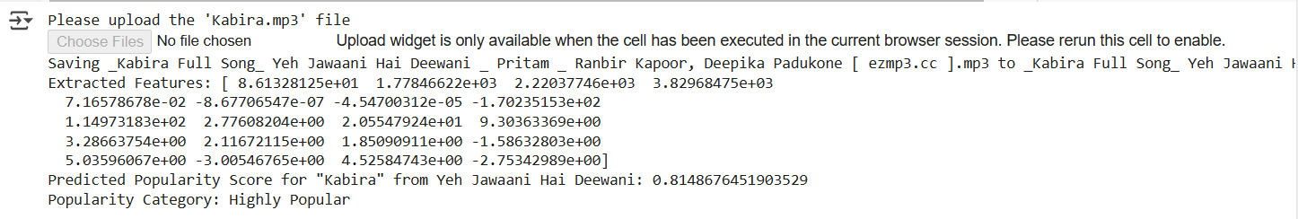
REAL-TIME PREDICTION

Slide 29
SUMMARY
The goal of the project was to classify a song based on its popularity into 3 categories- Low popular, Moderately Popular and Highly Popular.
A 60-40 split was identified as optimal and offering a perfect balance between sufficient training data for model learning and reliable evaluation on unseen data.
For the given dataset, the Artifical Neural Networks Algorithm demonstrated the highest accuracy of 94.5%, outperforming other models
However, after removing high multicollinearity variables, the Artificial Neural Networks Algorithm delivered the best results with an accuracy of 94%, highlighting its ability to adapt effectively to reduced feature sets.
The real-time prediction system successfully extracts audio features from any song and classifies its popularity instantly, demonstrating practical applicability in music analytics and streaming insights.

Slide 30
FUTURE SCOPE
Integration with Streaming Platforms – The model can be integrated with Spotify, Apple Music, or YouTube Music to analyze real-time streaming trends and improve recommendation systems.
Artist & Label Insights – Helping music producers and record labels evaluate a song’s potential success before release, optimizing marketing strategies.
Multilingual & Genre-Specific Models – Training models for different languages and genres (e.g., K-pop, Indie, EDM) to provide customized popularity predictions.
Real-Time Music Trend Prediction – Expanding the model to predict future popularity trends based on historical data and current listening patterns.

Slide 31


THANK YOU!!
COLAB NOTEBOOK
Presented By :
VENKAT ROHAN SEETEPALLI

